Slide 1
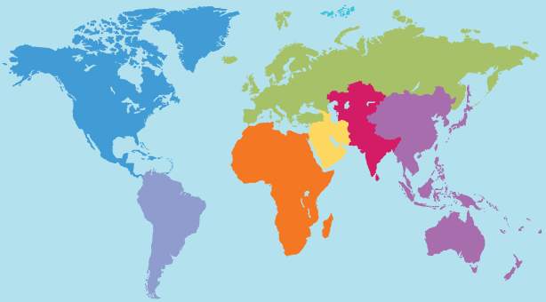
The first plane leg – Derby to Perth to Sydney to LA to Vancouver – 1/3/11 to3/3/11
The second plane leg – Vancouver to LA to New York – 8/3/11 to 22/3/11
The third plane leg – New York to London to Barcelone – 22/3/11 to 23/3/11
La grand boucle – the big bicycle lap of Europe – March to July 2011
The return plane leg – London to Singapore to Perth to Derby – late July2011
The drive to thenew home – Derby to Darwin – August 2011

